Slide 1

Does the rise of Winery growth influence Regional dynamics?
Presented by: Eli, Luis, Raquel

Slide 2
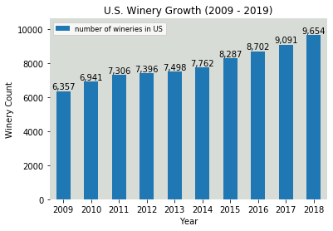

Slide 3
Initial considerations
Theory
Winery presence in the US has increased by 58% over the past 10 years. Where has that growth been strong? What impact has it had on local economy, health, crash and population?
Data Limitations
While a broad reach of data is available, limits to free sets at a city/county level across the information being sought proved less available resulting in pulling back to a state level analysis. Similarly, years of available data were not always consistent and restricted some comparisons as a result.
Outcomes
Given time constraints we ultimately focused on 5 of the most well-known wine states for our analysis. While there are some correlations, we found that items we assumed might have stronger links were not directly relevant and others may be more influenced by additional factors we did not have time to review during this project.

Slide 4
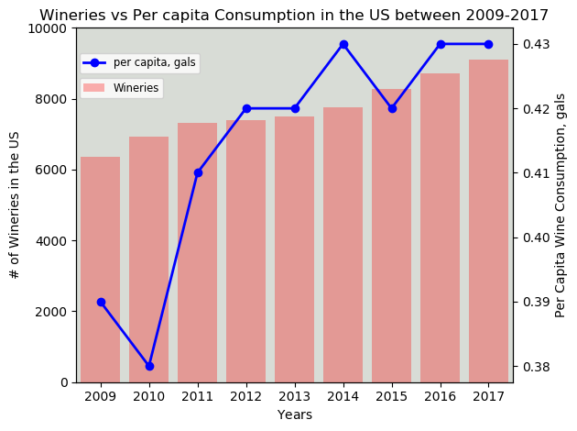
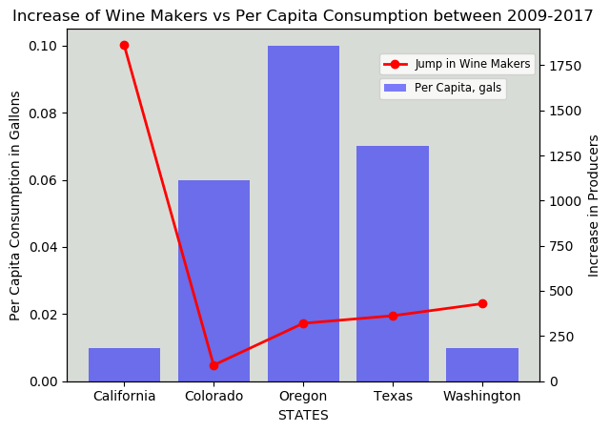
Winery growth and consumption
Fun Facts
The US is the fourth biggest wine producing nation in the Planet, right after France, Spain and Italy
Wine Production in the US dates back to the 16th century, when the French Huguenot settlers made wine in Jacksonville, Florida using Scuppernong grapes
89% of all American wine is produced in California
Data analyzed was narrowed from 2009 to 2017
US consumption per capita rose steadily along with the number of new wineries
On a state-wide basis, the biggest jump in wine producers came from California. However wine consumption per capita in this state saw lowest growth of the considered group
Highest increase in wine consumption per capita appears to occur in Oregon, closely followed by Texas (woo-hoo!!)

Slide 5
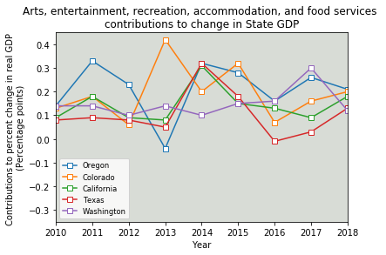
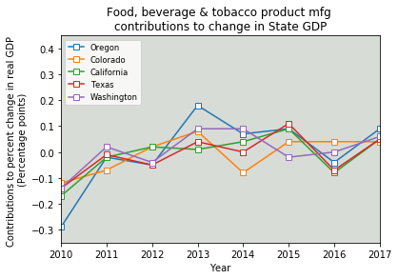
Tourism economic impacts
In general, the categories impacted most by tourism have impacted the overall Gross Domestic Product positively of each state the years shown. However, this may be more impacted by natural aesthetic and seasonal draws such as beaches, mountains, etc. than necessarily the wineries alone.
When drilling down further to the impact of food, beverage and tobacco production in which our winery data would be found, this segment across all states has played a smaller but very similar relative impact to each state since 2010.

Slide 6
Price Parity/affordability

Slide 7
Crash FATALITY rates

Slide 8
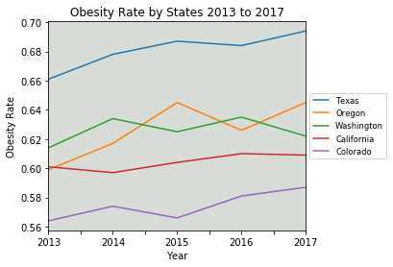
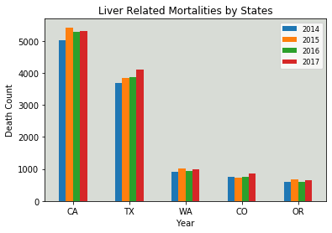
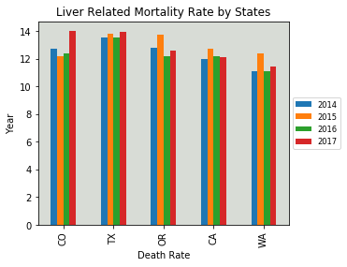
Health implications
While some regions show health concerns associated to alcohol/wine consumption, we found correlation limited based on the data readily available.
Colorado proved our outlier with some the largest shifts in mortality and obesity rates during the years measured.

Slide 9
summary

Slide 10
Appendix & references

Slide 11
references
Wine & Vines
US Census Bureau
Department of the Treasury, Alcohol, Tobacco Tax and Trade Bureau
National Institute on Alcohol Abuse and Alcoholism
Bureau of Economic Analysis
Centers for Disease Control and Prevention
Kaiser Family Foundation
National Low Income Housing Coalition
National Highway Traffic Safety Administration (API)
Everyvine
VinePair
The preceding analysis was based on data obtained from these sources.
Unless noted, data files were obtained as csv files.

Slide 12
Appendix: Next Steps
Different alcohol types and influence
Further dives in crash data to more localized sections
Review for external influencing factors in health concerns
Review economic impacts from downturns on overall spend and consumption

Slide 13
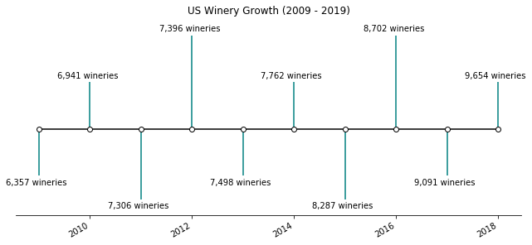
Appendix: Unused Charts

